Slide 1

RAILWAY RESERVATION SYSTEM (Online Train Ticket Booking)

Slide 2
ABSTRACT
The main aim of the project was to develop a website which would facilitate the reservation of online train tickets through an effective and yet simple GUI for a normal passenger intending to travel in trains. Apart from reserving tickets, through our system a passenger can compare online fares ‘from’ one city ‘to’ other cities.

Slide 3
MODULES
Booking: The system can book online tickets of the passengers, where they want to go.
Cancellation: The passengers can cancel their train tickets as usually.
Passenger Details: The System stores all the necessary information of the passengers.

Slide 4
MODULES
Trains: It shows the train schedule such as bus time, arrival and departure time etc.
Search:
This is provided the search options of the system that can search any related information of the system.
Report:
This shows the reports in different fields of the system.

Slide 5
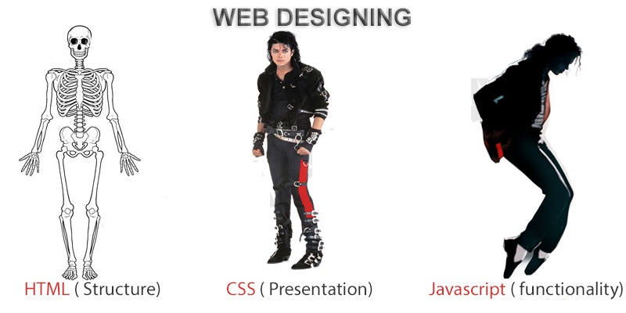
FRONTEND (LANGUAGE USED)
HTML (HYPERTEXT MARKUP LANGUAGE)
CSS (CASCADING STYLE SHEET)
BOOTSTRAP (FRAMEWORK OF CSS AND JS)

Slide 6

BACKEND
PYTHON DJANGO
SQLITE (DATABASE)

Slide 7
SOFTWARE USED
PYTHON INTERPRETER
PYCHARM IDE (INTEGRATED DEVELOPMENT ENVIRONMENT)
NOTEPAD++ OR ANY OTHER TEXT EDITOR
CHROME OR ANY OTHER BROWSER

Slide 8
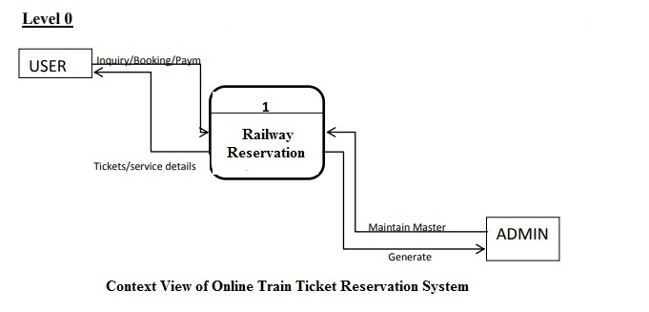
DFD(DATA FLOW DIAGRAM) Level - 0

Slide 9
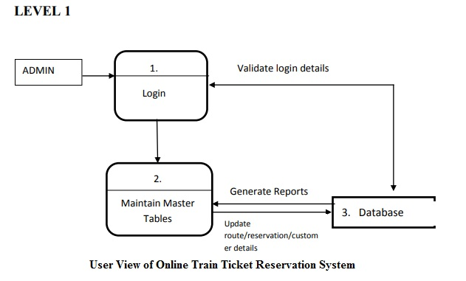
DFD(DATA FLOW DIAGRAM) Level - 1

Slide 10
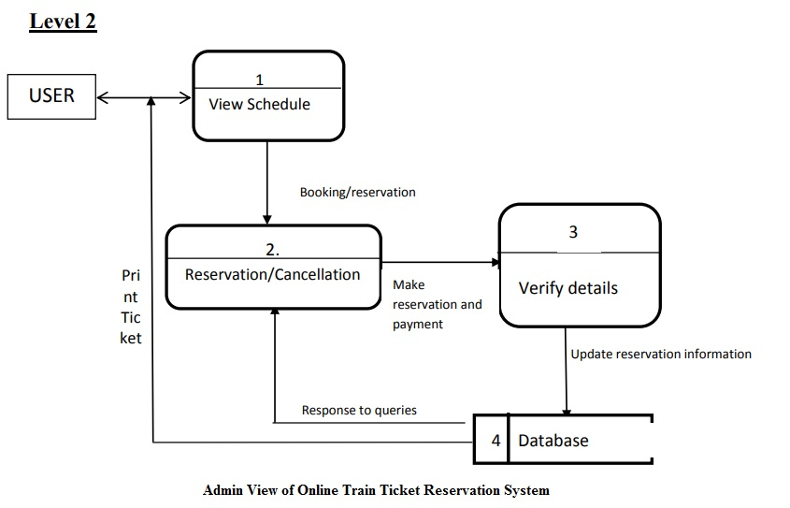
DFD(DATA FLOW DIAGRAM) Level - 2

Slide 11
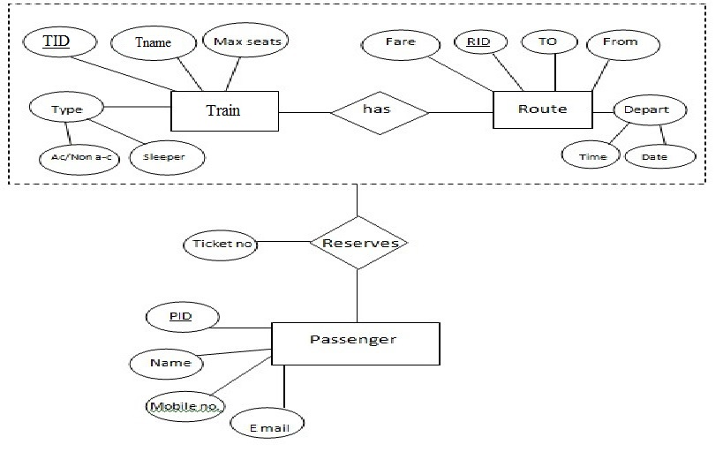
ER DIAGRAM

Slide 12
USE CASE DIAGRAM
Use case diagram consists of use cases and actors and shows the interaction between them. The key points are:
The main purpose is to show the interaction between the use cases and the actor.
To represent the system requirement from user’s perspective.
The use cases are the functions that are to be performed in the module.
An actor could be the end-user of the system or an external system.

Slide 13
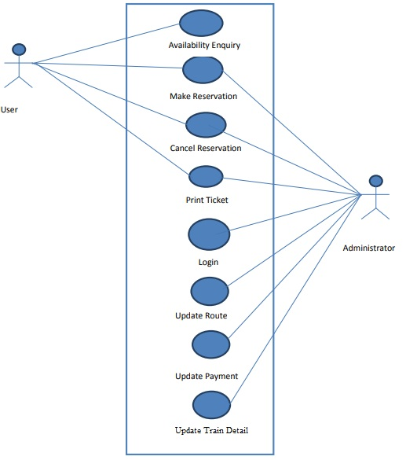
USE CASE DIAGRAM

Slide 14
SEQUENCE DIAGRAM
Login
Application
Database
Login
:Request
:Validate()
:executeQuery()
Response
Show Result
Failed:show()

Slide 15
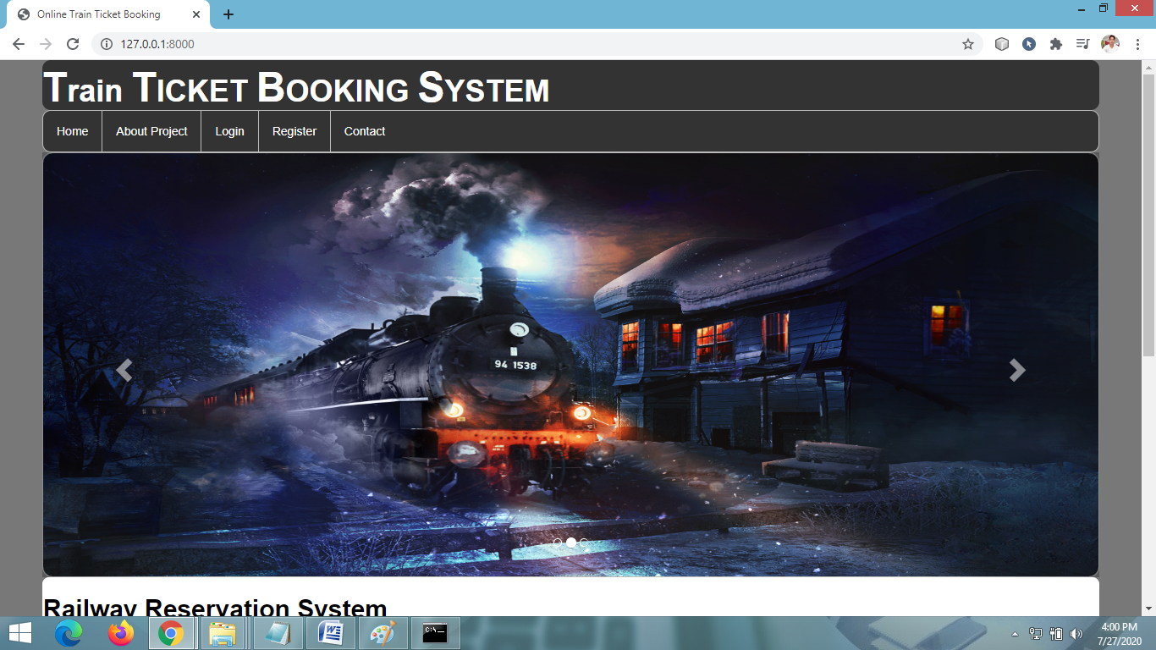
HOME PAGE

Slide 16
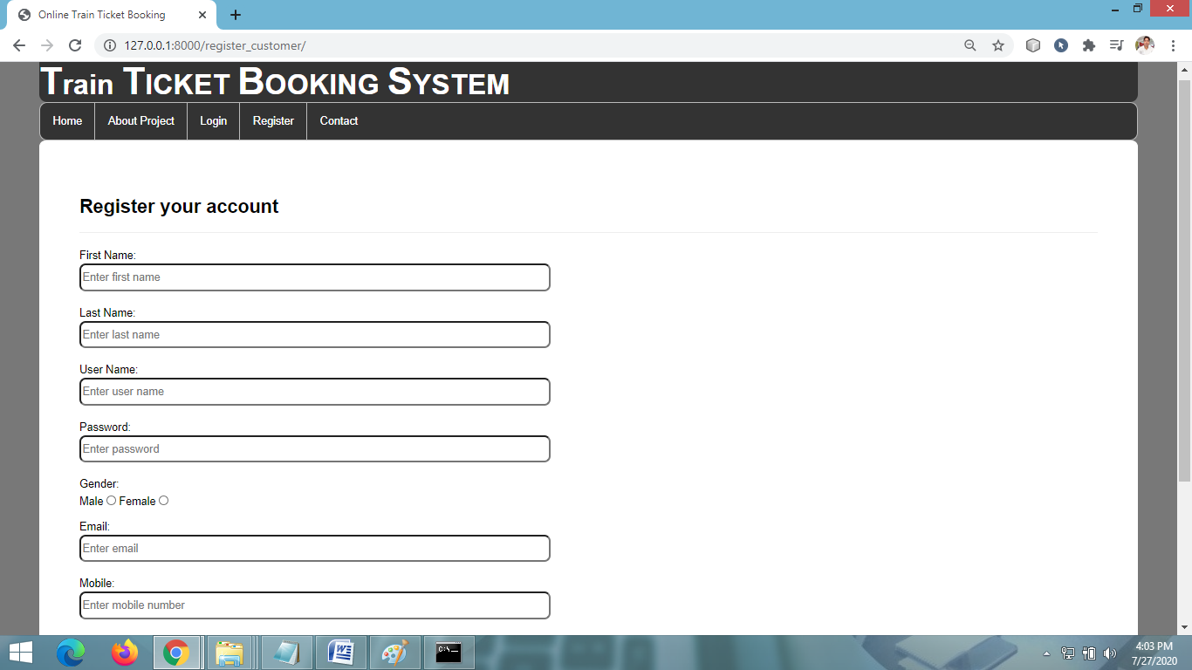
USER REGISTRATION PAGE

Slide 17
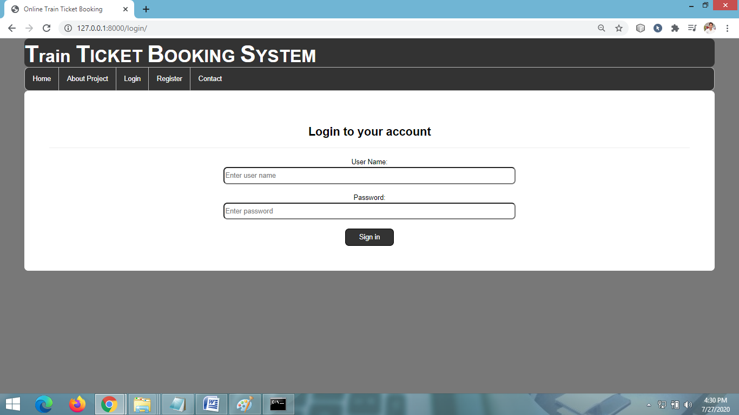
LOGIN PAGE

Slide 18
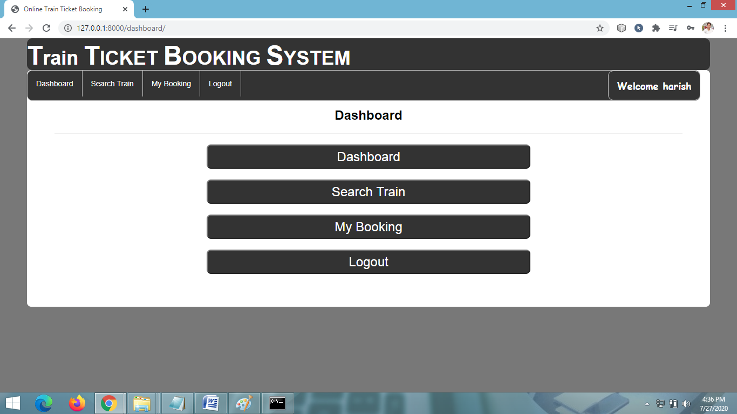
USER DASHBOARD

Slide 19
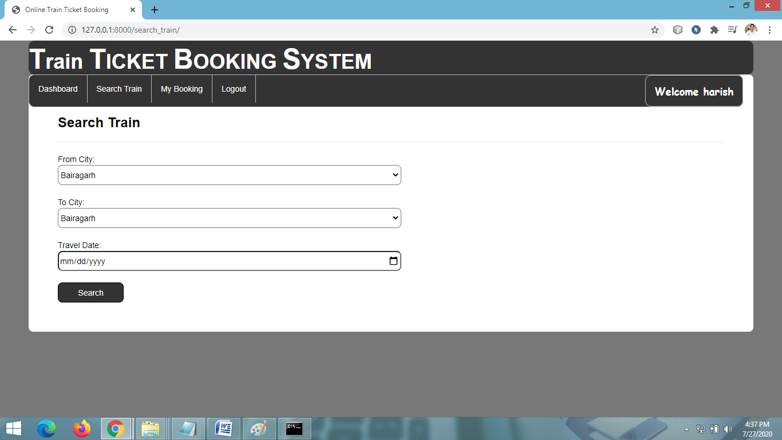
SEARCH TRAIN

Slide 20
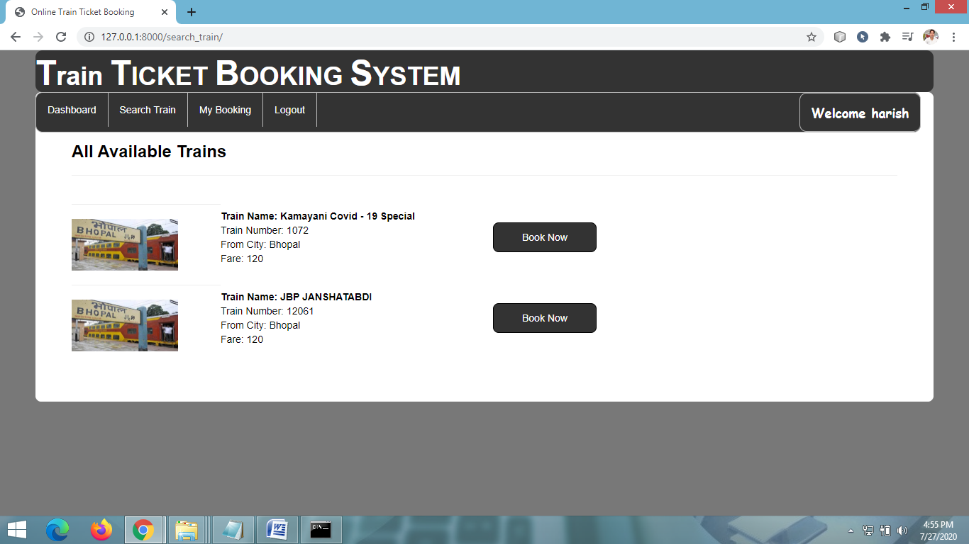
VIEW AVAILABLE TRAIN

Slide 21
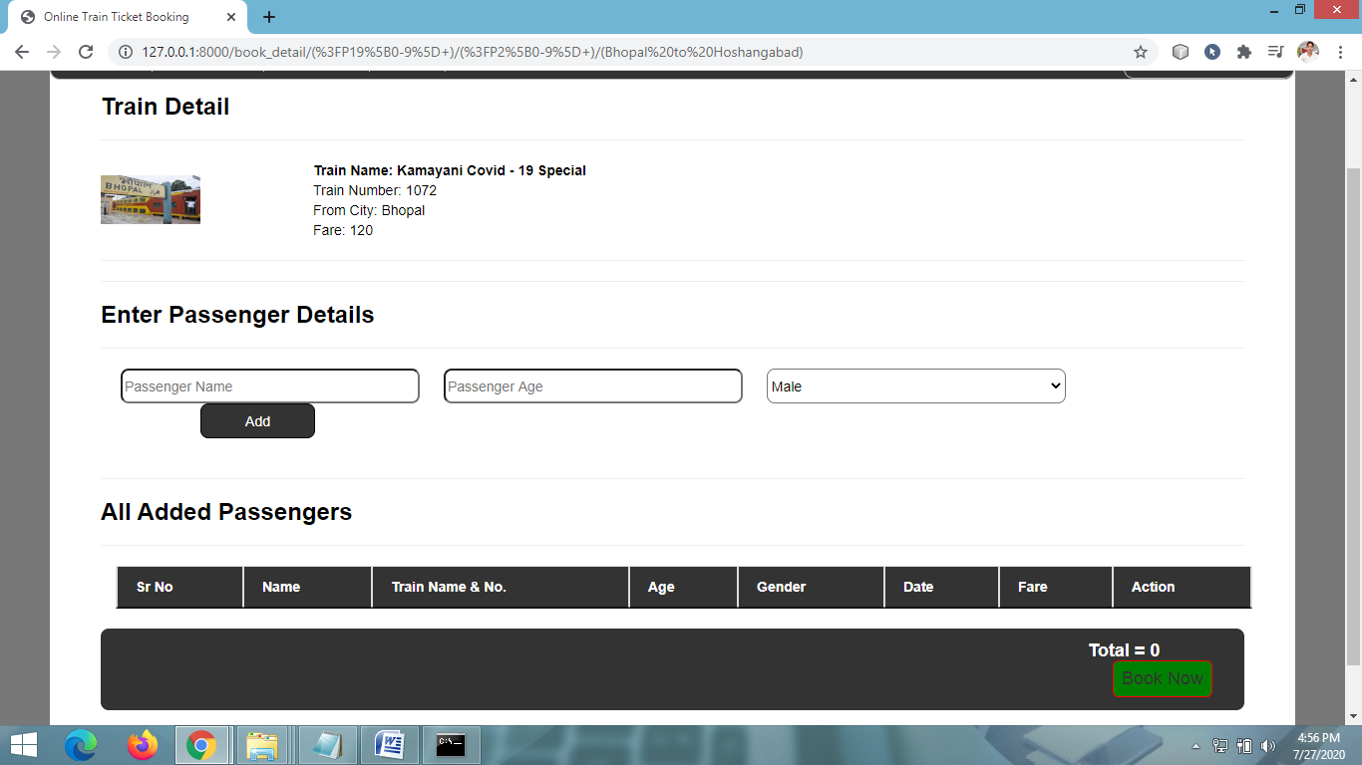
ENTER PASSENGER DETAILS

Slide 22
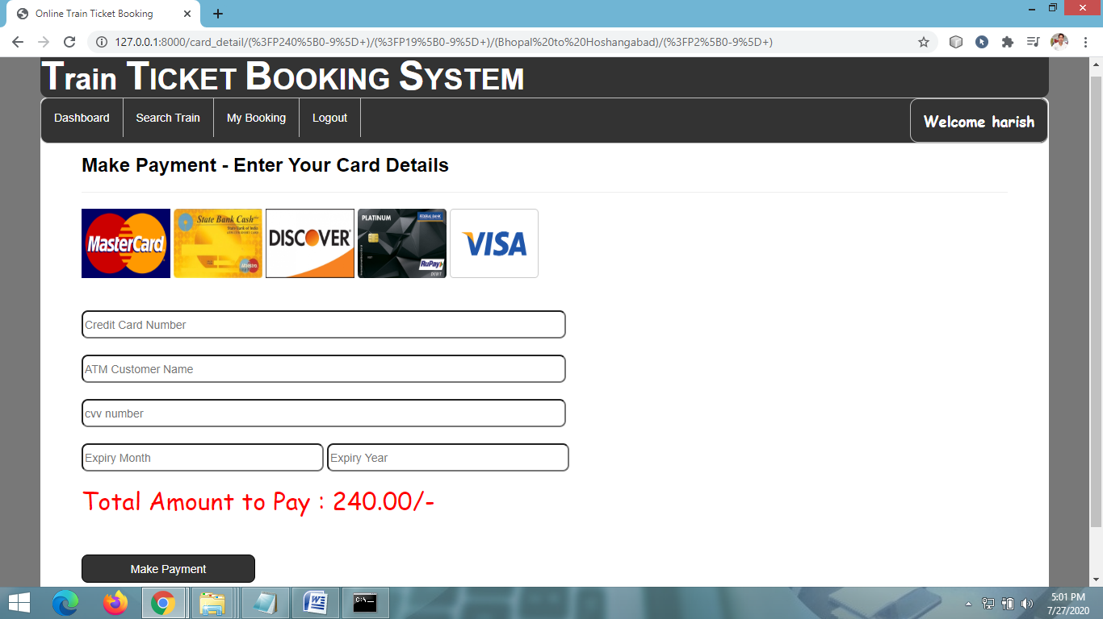
MAKE PAYMENT PAGE

Slide 23
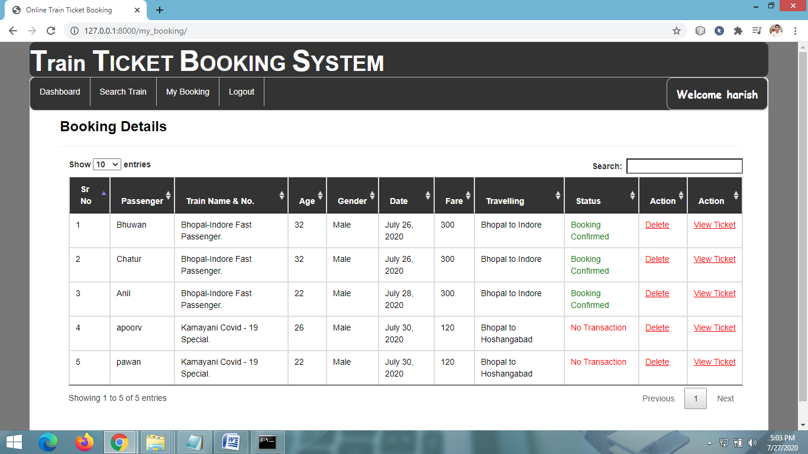
BOOKING DETAILS(User)

Slide 24
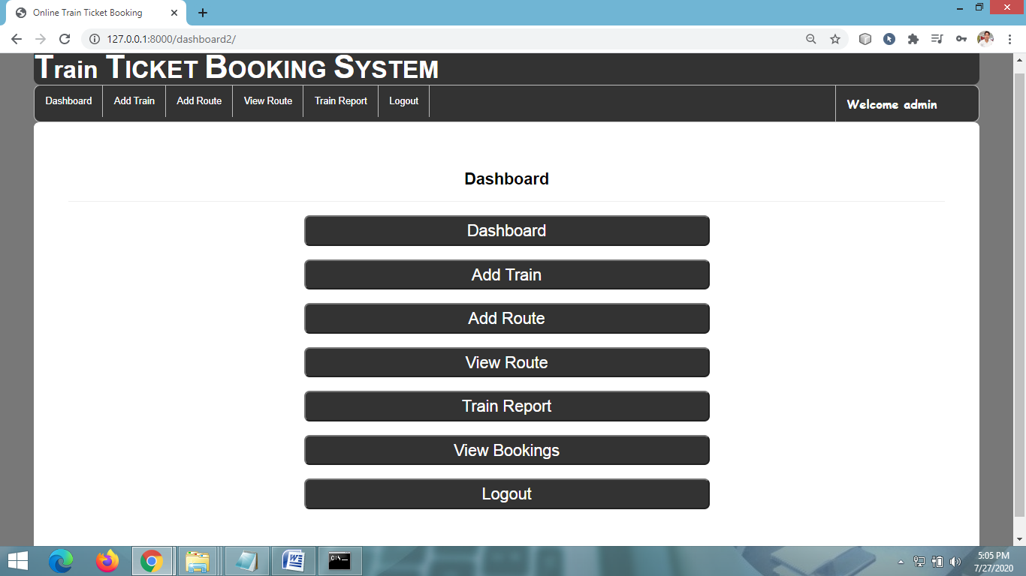
ADMIN DASHBOARD

Slide 25
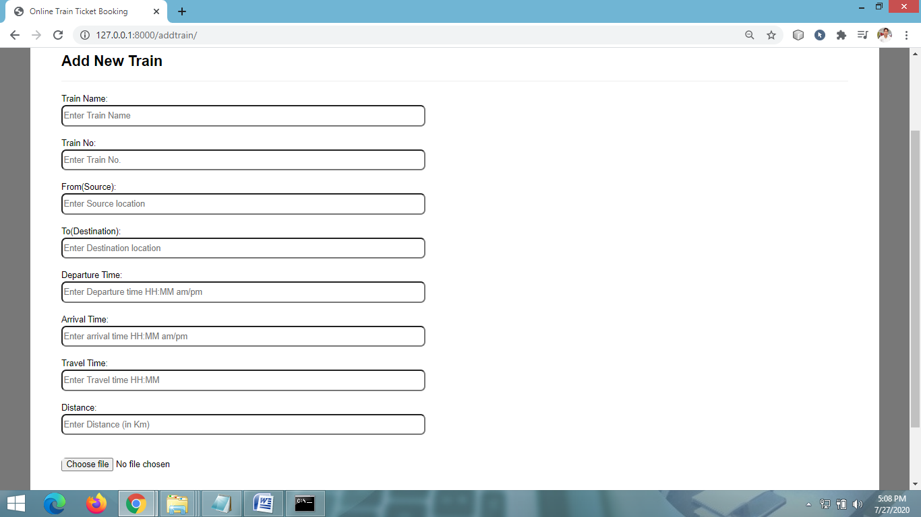
ADD NEW TRAIN DETAIL PAGE

Slide 26
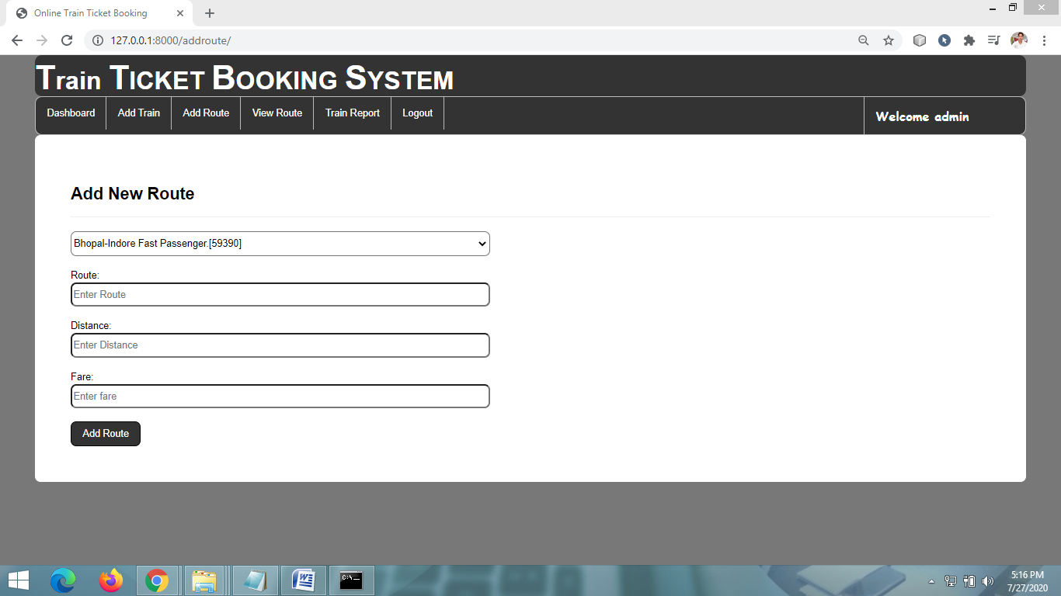
ADD NEW TRAIN ROUTE PAGE

Slide 27
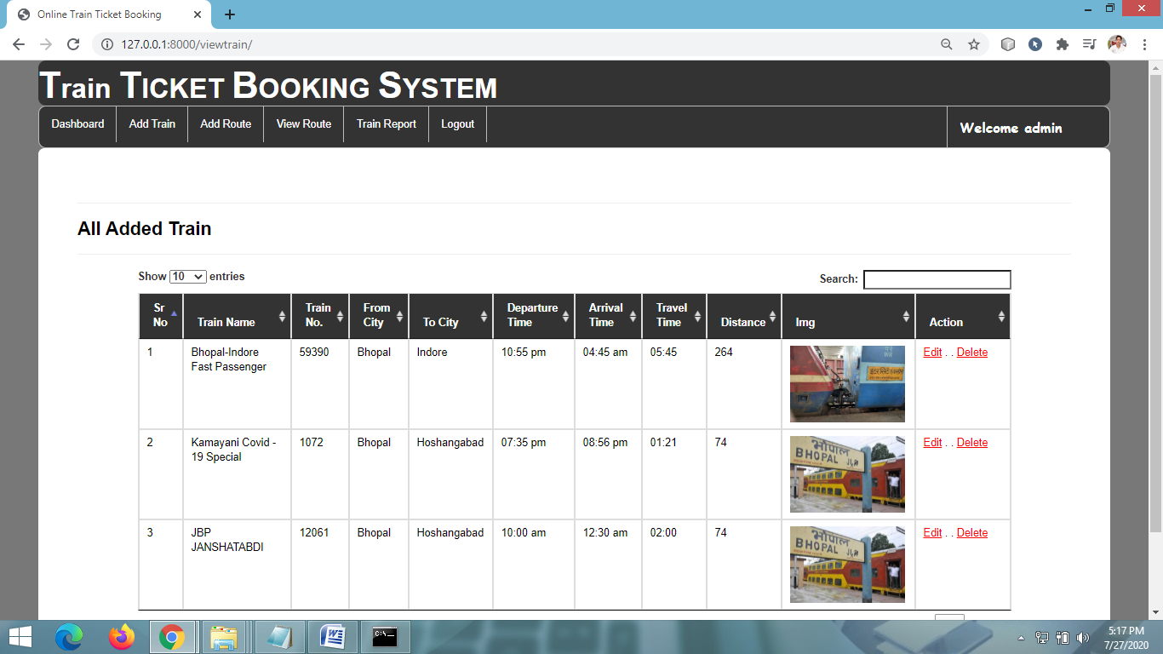
VIEW ALL TRAIN DETAILS PAGE

Slide 28
CONCLUSION & FUTURE SCOPE
FUTURE SCOPE
This web application involves almost all the features of the online train ticket booking. The future implementation will be online help for the customers and chatting with website administrator.
CONCLUSION
The project entitled “Online Train Ticket Booking” is developed using HTML, CSS and Bootstrap as front end and Python Django and Sqlite database in back end to computerize the process of online bus ticket booking. This project covers only the basic features required.

Slide 29
BIBLIOGRAPHY
FOR PYTHON INSTALLATION
https://www.python.org
FOR HTML , CSS ANF PYTHON BASICS
www.w3schools.com
www.javatpoint.com
https://www.geeksforgeeks.org/python-django/
REFERENCE BOOKS
Two scoops of Django for 1.11 by Daniel Greenfeld’s and Audrey Greenfield
Lightweight Django by Elman and Mark Lavin

